Slide 1

The Power of Donations and Philanthropy Tracking
Hacks 8.0: TriCoders

Slide 2


Problem Statement
In the realm of philanthropy and charitable donations, transparency, accountability, and trust are paramount for both donors and beneficiaries. Developing a secure and transparent platform that effectively tracks and manages donations, ensuring that funds reach intended causes and demonstrating their impact, is essential. The challenge in this hackathon is to design and build an innovative, transparent platform that enhances security, and traceability in the domain of donations and philanthropy.

Slide 3

Introduction
To influence change, many non-profit groups and social causes rely on philanthropy, but accurately tracking gifts can be difficult. In this session, we'll look at creative ways to track donations, talk about the advantages of effective philanthropy, and offer suggestions that can help organizations have the biggest possible impact. We want to improve the world one donation at a time by utilizing cutting-edge design and technological innovations. Let's get going and see how we can apply our abilities to support philanthropy and tackle global issues.

Slide 4
Why Donate & Track Philanthropy?
Philanthropy funds charity, non-profits, and research; maximizes social impact.
Technology aids tracking, analysis, and resource allocation; streamlines operations, investigating out inefficiencies.
Donating and tracking philanthropy creates a lasting impact that improves the world for everyone.
Tracking donations ensures accountability, transparency, and optimization; evaluates impact.

Slide 5
Chart

Slide 6
Chart Explanation
We compared the needed funding and the actual financial help provided certain natural disasters. The blue bars represent the needed funding for relief and recovery efforts, while the darker shade of blue bars represent the actual financial help provided.
The needed funding was significantly higher than the actual help provided. Hurricane Harvey needed an estimated $125 billion, but received less than $10 billion in federal funding. (8%)
The 2018 California Wildfires needed an estimated $18.4 billion, but only received $3.9 billion in federal funding. (~22%)
The 2017 Mexico Earthquake needed an estimated $2.8 billion, but only received $800 million in international aid.(<0.30%)

Slide 7
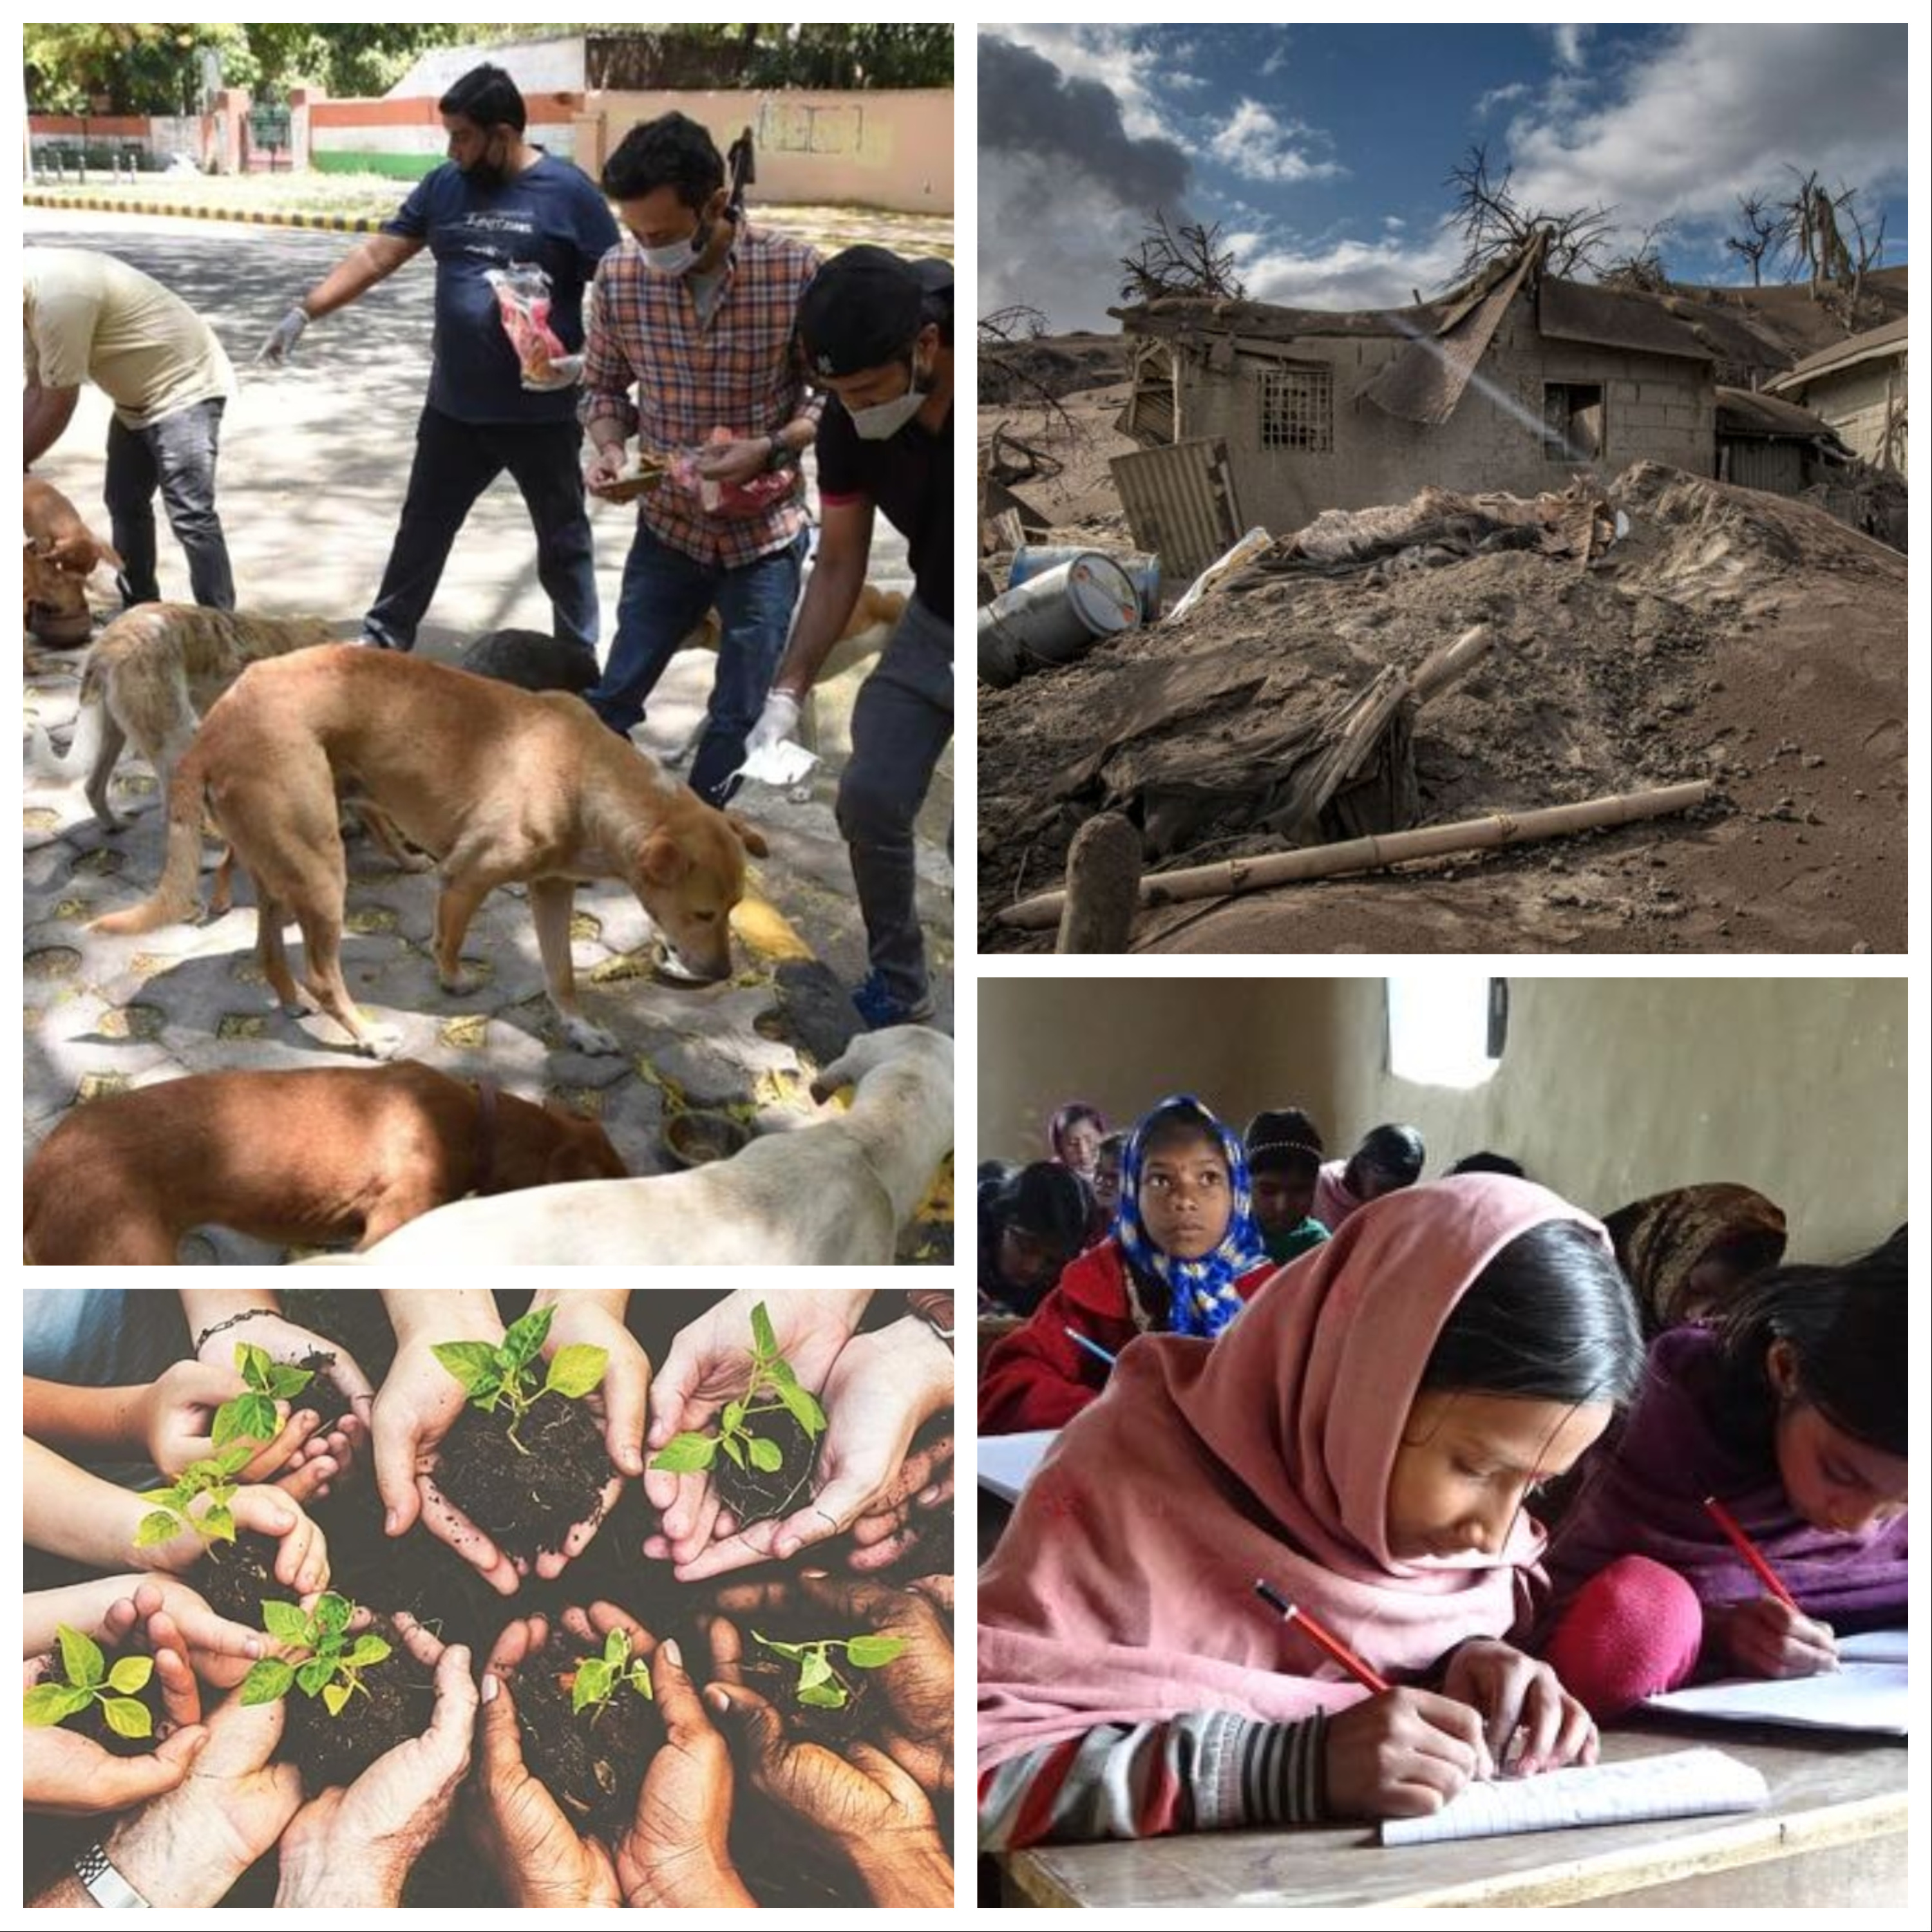

Slide 8
Different Causes and organisations we plan to help
Education - Provides funding and resources to support education, such as building schools, providing books and supplies, or offering scholarships and grants to students and teachers.
Food for the less privileged - Helps provide food to people who are struggling with poverty, homelessness, or other financial difficulties. This could include food banks, meal programs, or volunteer efforts.
Disaster-Relief - Provides support and resources to help communities recover from natural disasters such as hurricanes, earthquakes, or wildfires. This could include providing shelter, food, and medical assistance.
Orphanage support - Supports children who have been orphaned or are in need of care. This could include providing homes, education, medical care, and other resources to help children grow up in a safe and nurturing environment.

Slide 9
Different Causes and organisations we plan to help (pt. 2)
Donation drives - Collects and distributes clothing to people who are in need. This could include donating gently used clothing to shelters and charities, or organizing clothing drives in the community.
Environment - Addresses issues related to climate change, pollution, and ecological sustainability. This could include supporting conservation efforts, promoting renewable energy, or educating communities about environmental issues.
Feeding stray animals - Supports organizations that help provide food, shelter, and medical care to stray animals. This could include donating to animal rescue organizations, volunteering at animal shelters, or organizing local campaigns.

Slide 10
Implementation and Integration
Technical Requirements
How to Volunteer
Benefits
Secure web and mobile platforms
Cloud-based architecture to store and process information
Fully integrated with all popular payment gateways
Choose any part of the organisation you’d like to support
Connect with other volunteers on the platform
Help the ones in need as a team!
Your donations can have a greater impact with our robust tracking and management features. We believe in making smart giving choices that maximize the global impact.

Slide 11
Our Plan
We plan to help as much charities, causes possible which can be achieved with continuous support of the masses
We also aim to include a tracking system which would help people who have donated figure where and what for what cause their money was used
Our main objective is to ease the lives of the less privileged, and make the world a better place

Slide 12
Future Prospects
We can add - Cryptocurrency Donations, Crowdfunding Campaigns, Mobile Wallet Integration
AI and Machine Learning: Implement AI and machine learning algorithms to analyze donor behavior and preferences. Use predictive analytics to recommend causes and donation opportunities to users.
AI-Powered Chatbots and Support: - Use AI-powered chatbots to provide immediate assistance to donors and beneficiaries, enhancing user support and engagement.
Open Source and Community Contributions: - Consider making parts of your platform open source to encourage community contributions and innovation.

Slide 13
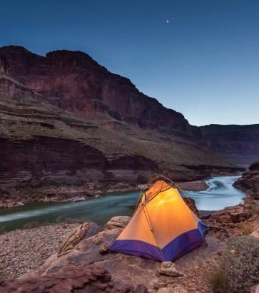

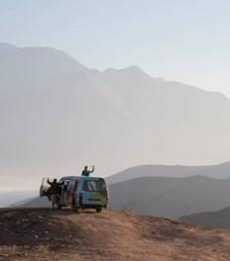
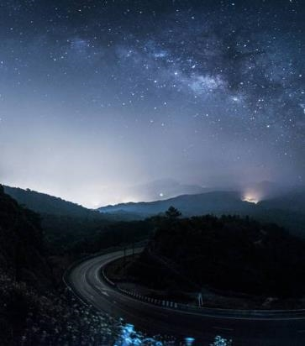
Conclusion
In conclusion, we have explored several important topics that can greatly impact the lives of individuals and communities. From supporting education and disaster relief efforts to providing food, shelter, and care to those in need, each of these causes has the potential to create positive change in the world. By working together and taking action towards these goals, we can make a meaningful impact and create a brighter future for generations to come.

Slide 14

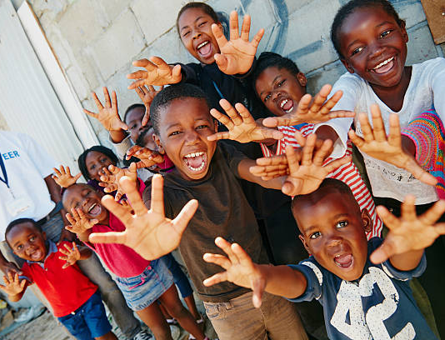
Thank you!!
TriCoders:
Omkar Shete
Prathamesh Nimkar
Tarun Pradhan

